Slide 1
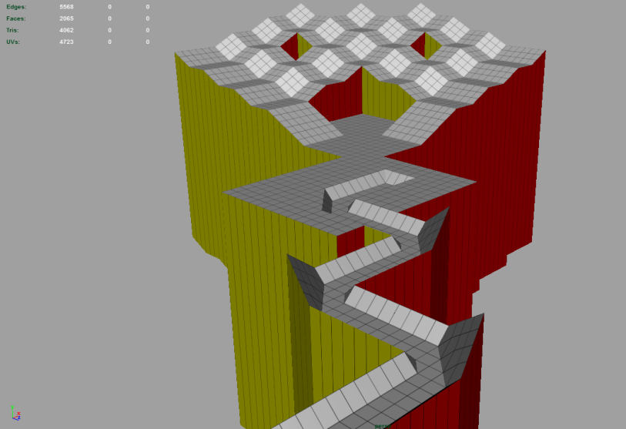
Game Technology
Lecture 9 – 12.12.2014
Physics 2
Dr.-Ing. Florian Mehm
Dipl-Inf. Robert Konrad

Slide 2
Preliminary timetable
Lecture No. | Date | Topic
1 | 17.10.2014 | Basic Input & Output
2 | 24.10.2014 | Timing & Basic Game Mechanics
3 | 31.10.2014 | Software Rendering 1
4 | 07.11.2014 | Software Rendering 2
5 | 14.11.2014 | Basic Hardware Rendering
6 | 21.11.2014 | Animations
7 | 28.11.2014 | Physically-based Rendering
8 | 05.12.2014 | Physics 1
9 | 12.12.2014 | Physics 2
10 | 19.12.2014 | Procedural Content Generation
11 | 16.01.2015 | Compression & Streaming
12 | 23.01.2015 | Multiplayer
13 | 30.01.2015 | Audio
14 | 06.02.2015 | Scripting
15 | 13.02.2015 | AI

Slide 3

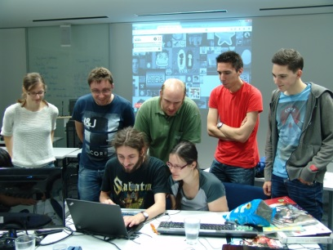
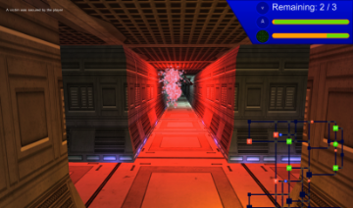
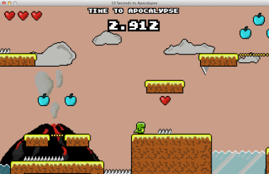
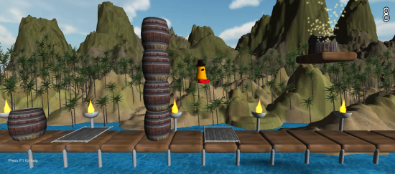


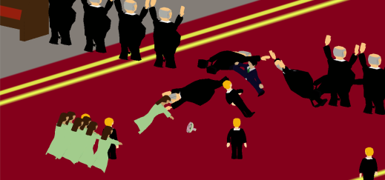

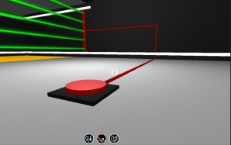
Announcement
Game Jams
Game development contest
Vague theme (e.g. “10 seconds”)
Tight time constraints (e.g. 48 h)
Starting from scratch (design, assets, code, …)
No excuses – just submit something…
Global Game Jam 2015@TUD
Fr., 23.01.2015, 17:00 – So, 25.01.2015, 17:00
Registration (first-come-first-serve): gamejam@kom.tu-darmstadt.de
The Head Wizards Course, 2014
Ludum Dare 30 @ TUD, 2014
A Maze Thing, 2013
10 Seconds to Apocalypse, 2013
10sion, 2013
10Up Experiments: Mountain Brew, 2014
The Most Important 10 Seconds Of Your Life, 2013
As We Are, 2014
Neon Multiverse, 2014
Notes:
Unity als praktischer Einstieg - Features

Slide 4
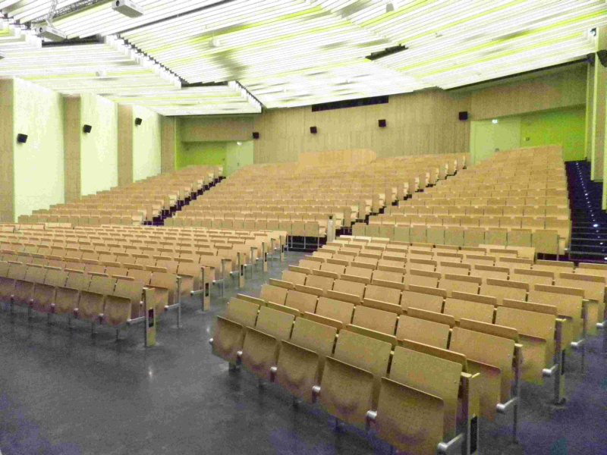
Announcement 2
The exam is now scheduled for
Friday, 06. March 2015
09-11 AM
S101/A1

Slide 5
Adding Physics to Marbellous
Collision with the level
Level supplied by artist as 3D mesh
How to handle the collisions with the mesh?
Friction
Handle rotations
Add friction
Controls
Apply forces when keys are pressed
(Camera control
Keep the ball in view
Don‘t follow every single movement)

Slide 6

Hand-placed colliders
Sometimes good placeholders for objects or level geometry
Planes
Ground plane
Simple intersection
Boxes
Spheres
Capsules

Slide 7

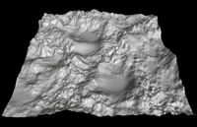
Height map
Supplied as a texture or generated
Gives height values at grid points
By interpolating, we can find the height of the mesh under the sphere and the normal

Slide 8
Using the mesh itself
Intersection with triangles
Check all triangles
If sphere intersects a triangle, handle the collision

Slide 9
Using the mesh itself
Intersection with triangles
Check all triangles
If sphere intersects a triangle, handle the collision
If there are multiple collisions
Handle only one (most prominent)
Handle all
?

Slide 10
Separating Axis Test
If two objects are separated, there must be an axis which separates the two objects
(„Separating Axis Theorem“ → Not a theorem – follows from Hyperplane separation theorem by Hermann Minkowski)
First mentioned in computer graphics in 1995

Slide 11
Separating Axis Test
More exact
There must be points P1 and P2 of objects 1 and 2 such that the normal resulting from P2 – P1 is a separating axis
Separating Axis
Project all points of the objects onto the separating axis
We get the minimal and maximal points min1, min2 and max1, max2
The objects are separated iff max1 < min1 or max2 < min1
min1
max1
min2
max2

Slide 12
Separating Axis Test
Infinite set of possible points to test for
It can be proven that an upper boundary exists
Only the relevant axes have to be tested for
If separation exists on any axis, the test is done → early out for positive test result
If no separation exists, we still have to test all combinations of features → no early out for negative tests
Can be more efficient to reject the test based on other information, e.g. bounding boxes
For polygonal objects, the features are
Faces
Edges
Vertices

Slide 13
Separating axes for spheres
Spheres have no clear feature points
We have already used the separating axis test, though
The relevant features for two spheres are the two closest points of the spheres
We find them by finding the axis from one sphere‘s center to the other‘s center
The intersection test in the previous lecture used this axis for testing intersections
P1
P2
min1
max1
min2
max2

Slide 14
Triangle-Sphere-Test
Relevant Features of the Triangle
Face (x1)
Vertices (x3)
Edges (x3)
Relevant feature of the sphere
The point on the surface closest to the feature of the triangle

Slide 15
SAT: Testing the plane of the triangle
(We have done this test already – need to define the plane)
Normal: Use the cross product (very useful for finding normal vectors)
n = normalize((B – A) x (C - A))
Distance
Insert one of the points into the equation for distance
n*A – d = 0 (since A lies on the plane of the triangle)
→n*A = d
Test for separation
Separation = distance(Plane, P) > r
r
P
B
A
C

Slide 16
SAT: Vertices
Here shown for A (similar for B and C)
Finding the sphere‘s feature
Along the line from A to P
Compute distance from A to P
Separation (along this axis) iff
Distance d > r
And B and C lie on the opposite side of the separating plane
r
P
B
A
C

Slide 17
SAT: Vertices
Separation (along this axis) iff
Distance d > r
And B and C lie on the opposite side of the separating plane
B
P
A
C

Slide 18
SAT: Vertices
Separation (along this axis) iff
Distance d > r
And B and C lie on the opposite side of the separating plane
B
P
A
C

Slide 19
SAT: Vertices
Separation (along this axis) iff
Distance d > r
And B and C lie on the opposite side of the separating plane
B
P
A
C

Slide 20
SAT: Vertices
Separation (along this axis) iff
Distance d > r
And B and C lie on the opposite side of the plane
We assume that A-P is the separating axis
No check if A is the closest point
B and C might be separating axes!
P
B
A
C

Slide 21
SAT: Edges
Here shown: AB
Find a point for Q for which Q-P is a normal vector orthogonal to AB
Projection of P onto AB
Use the dot product (ideal for projecting vectors onto each other)
Determine the distance d of Q to P
AB defines a separating axis iff
Distance d > r
C lies on the other side of the plane through AB with normal PQ
P
B
AB
BC
AC
A
C

Slide 22
SAT: Edges
AB defines a separating axis iff
Distance d > r
C lies on the other side of the plane through AB with normal PQ
P
B
AB
BC
AC
A
C

Slide 23
SAT: Edges
AB defines a separating axis iff
Distance d > r
C lies on the other side of the plane through AB with normal PQ
B
P
AB
BC
AC
A
C

Slide 24
SAT: Edges
AB defines a separating axis iff
Distance d > r
C lies on the other side of the plane through AB with normal PQ
B
AB
BC
P
AC
A
C

Slide 25
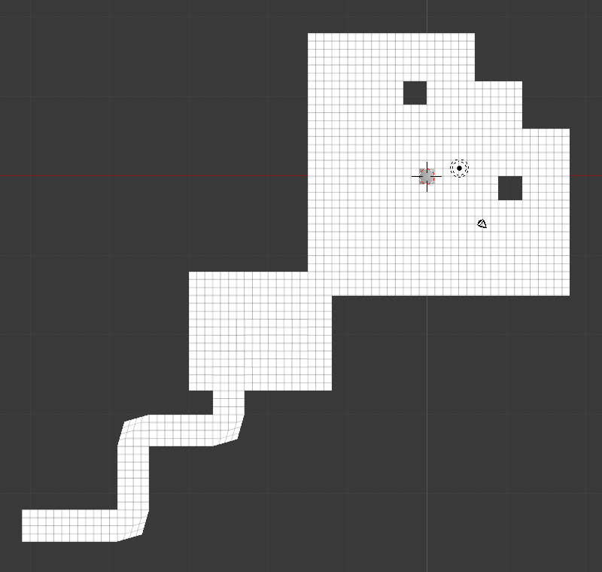
Speeding the calculation up
Note: In our case, the level is essentially 2D
Most of our collisions will be from the top of the level
Use a space partition
Regular Grid
Quadtree
KD-Tree
BSP

Slide 26
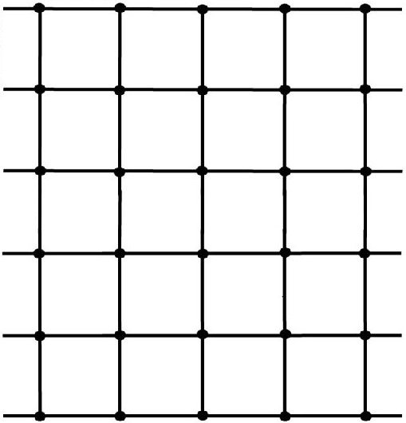
Regular grid
Subdivide space regularly
E.g. specify
Cell size in units
Start point
For each cell
Test if an object intersects (partly) with the cell
If so, save a reference to this object
(Objects can be in several cells)
Advantages
Easy to compute
Lookup of cells is trivial
Disadvantages
Sparsity kills the performance
Clusters
Start point
Cell size

Slide 27
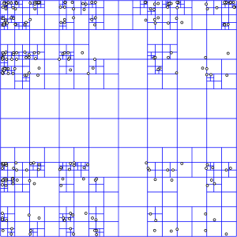
Quadtree(2D), Octree(3D)
Start with a rectangular shape
Subdivide the space into 4 or 8 subdivisions of equal size if the number of contained objects is too large
Until the required minimal number of objects per subdivision is found
Advantages
Still simple lookup where an object is placed
Can handle clusters better
Disadvantages
Can cope less with changing number and position of objects

Slide 28
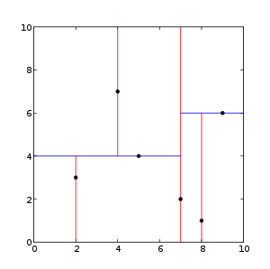
KD-Tree
Similar idea to Quad/Octree
Subdivide starting from a rectangular shape
Choose the subdividing line
E.g. median point of the contained objects (cutting them in half)
Alternate axes for subdivision
Advantages:
Well suited for clusters
Disadvantages
Lookup harder than octree

Slide 29
Binary Space Partition
Generalization of KD-Tree
Subdivide the space into half-spaces with arbitrary planes
Used previously to speed up rendering (Quake Engine)

Slide 30
Reducing the dimensionality
Many problems in 3D games are essentially 2D
Heightmaps
Top-down shooters
Real-Time Strategy games
...
In Marbellous, we can expect that
No overhangs are present in the level
The sphere will stay close to the mesh at all times
If we look at the level from above, we can see that if we put a grid over the game world, only the triangles in the same 2D cell can be possibly colliding
→ During initial setup and the lookup, project everything into 2D

Slide 31
Lookup
Saving the triangles
We should save only the triangles that are contained in the grid cell
→ We need to check intersection between a rectangle and a triangle
Minimizing storage
Re-use the vertex and index buffer
Save only the index of the triangle
(Ideally, we will not suffer from too many cache misses, since the goal in the first place is to reject most collision tests early)

Slide 32
Intersection between the triangles and the grid
Re-use the scanline rasterization algorithm
Very similar task
But have to watch out due to larger cell size
Original algorithm
Find edge longest with biggest ydif
Fill lines between long edge and other edge 1
Fill lines between long edge and other edge 2

Slide 33
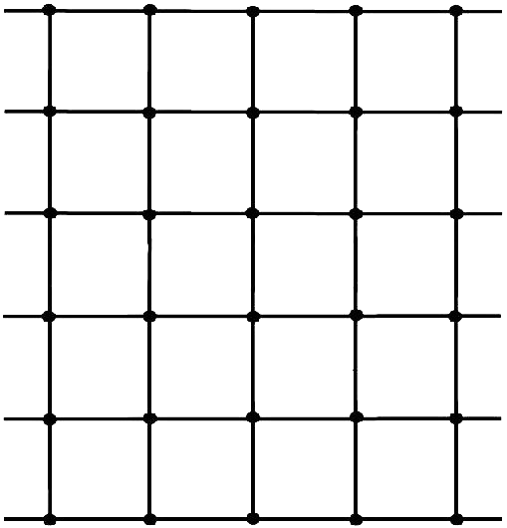
Triangle Rasterisation

Slide 34
Triangle Rasterisation

Slide 35
New algorithm
Calculate intersection with all grid lines
For each row
Left extent is the minimal intersection point
Right extent is the maximal intersection point

Slide 36
Triangle Rasterisation

Slide 37
Triangle Rasterisation

Slide 38
Intersection between the sphere and the grid
Use the bounding box of the sphere
Defined by the extents in the x-z-Plane
(Or implement rectangle-sphere intersection)

Slide 39
Is it worth it?
No (at least not for our exercise)
On a Core2 Duo @2.7 GHz, the intersection with the mesh takes about 0.908 ms in Release mode
But, for production code, larger meshes and more objects, it could become relevant
(Triangle-Sphere Intersection implemented with optimized code by Christer Ericson, http://realtimecollisiondetection.net/blog/?p=103)

Slide 40
Broad Phase vs. Narrow Phase
Broad Phase
Rule out as many possible collisions
Only call narrow phase if separation can not be proven here
Reduce the problem
Use spatial data structures (grid, octree, etc.)
Use bounding volumes (and bounding volume hierarchies)
Narrow Phase
Check for exact collisions
Use exact tests
E.g. based on SAT
Should be much slower than broad phase and therefore seldomly called
Provide collision data to resolver

Slide 41
Time Handling
Fixed Time Step
Explicit Time Step → Our method
(Semi-)Implicit Time Step Method
Try to predict the times of collisions and handle them at the beginning
Adaptive Time Step
Retroactive Detection
If there is interpenetration at t +deltaT, use deltaT *= 0.5 and retry
Conservative Advancement
Predict the next time of collision
Advance to this time

Slide 42
Continuous Collision Detection
Check if an object moved through another in the frame
On one side before, on one side after
Swept shape algorithms
Time of impact ordering
Go to time of impact, resolve there
Time Of Impact

Slide 43
Speculative Contact
Calculate the distance to the collider
Remove just enough velocity so they touch in the next frame

Slide 44
Speculative Contact
Calculate the distance to the collider
Remove just enough velocity so they touch in the next frame

Slide 45


Constraints
Stiff constraints
Keep objects at an exact length compared to each other
E.g. when attached to a steel cable
Springs
Variable length between objects
E.g. when attached to a bungee rope

Slide 46
Stiff Constraints - Rods
Distance between two objects is determined to stay constant
Separating Velocity between the two objects along the vector from one to the other should be 0 at all times

Slide 47
Stiff Constraints - Rods
Distance between two objects is determined to stay constant
Separating Velocity between the two objects along the vector from one to the other should be 0 at all times
Counter the velocity

Slide 48
Stiff Constraints - Rods
Distance between two objects is determined to stay constant
Separating Velocity between the two objects along the vector from one to the other should be 0 at all times

Slide 49
Spring Constraints
Model a spring between two objects (one might be stationary)
Spring force
Rest length (no force)
Stiffness
(Breaking point)

Slide 50
Hooke‘s Law
F = -k * (l – l0)
F: Spring force
k: Spring constant (stiffness)
l: Current length of the spring
l0: Rest length of the spring
Apply the resulting force to the objects that are attached
(One might be immovable)

Slide 51
Stiffness
Also a property of numerical systems
The stiffer, the more problems we face → exploding systems
J. D. Lambert : “If a numerical method with a finite region of absolute stability, applied to a system with any initial conditions, is forced to use in a certain interval of integration a steplength which is excessively small in relation to the smoothness of the exact solution in that interval, then the system is said to be stiff in that interval.”

Slide 52
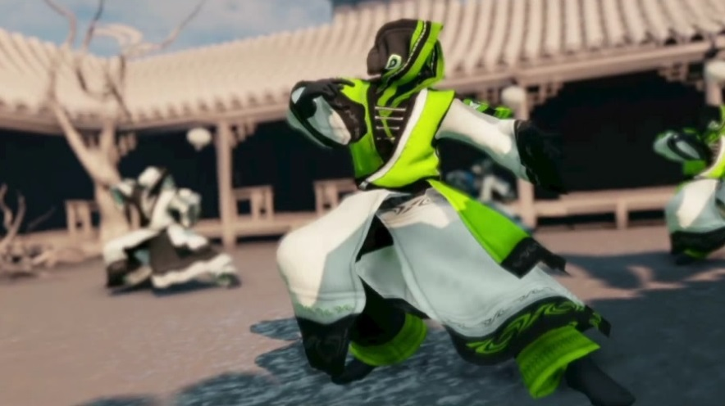
Particle networks
Connect multiple particles with springs
Approximation for deformable objects
Often used for cloth
Problems/Challenges
Stiff constraints
Self-intersections
Stability

Slide 53
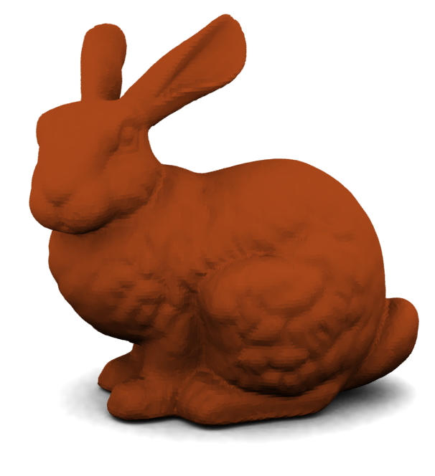
Deformable objects
Generalization of particle networks
Finite Element Method from Mechanics
Model forces inside the object
Stress
Strain
Gasses, Liquids
Discretize into a vector field
Calculate flow by solving the Navier-Stokes-Equations

Slide 54
Collision handling schemes
Impulse-based Micro-Collisions
What we are using
Spring-Based
Insert a spring at the point where the collision is detected
Forces the objects out again
Constraint-Based
Formulate the collisions as violations of constraints

Slide 55
Sequential Impulses
Aka. Propagating Impulses
Stability
Add iterations
Solve impulses in order of importance
Adaptive schemes
Few, „large“ contacts → need fewer iterations
Many contacts → need more iterations

Slide 56
Sequential Impulses
Aka. Propagating Impulses
Stability
Add iterations
Solve impulses in order of importance
Adaptive schemes
Few, „large“ contacts → need fewer iterations
Many contacts → need more iterations

Slide 57
Sequential Impulses
Aka. Propagating Impulses
Stability
Add iterations
Solve impulses in order of importance
Adaptive schemes
Few, „large“ contacts → need fewer iterations
Many contacts → need more iterations

Slide 58
Sequential Impulses
Aka. Propagating Impulses
Stability
Add iterations
Solve impulses in order of importance
Adaptive schemes
Few, „large“ contacts → need fewer iterations
Many contacts → need more iterations

Slide 59
Constraint-based
Constraint Vector
For each collision or constraint
Equality constraint
Objects should stay at a fixed relative position
Inequality constraints
E.g. for separating objects after collisions
For each collision, add a constraint to the constraint vector
Results in a large system of equations
Solve via Linear Complementarity Problem (LCP)

Slide 60
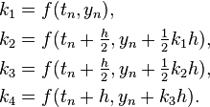
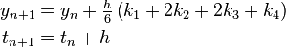
Other integrators
Runge Kutta 4th order (RK 4)
Approximate from 4 values
Velocity-less Verlet integration
Uses no explicitly saved velocity
Instead, uses position difference between this and previous calculation
x(t + deltaT) = 2 * x(t) – x(t – deltaT) + deltaT^2 * a

Slide 61
Rotation
Angular Velocity, Acceleration
Save as additional properties
Velocity: 3-Vector, Rotations around x, y, z axis
Accelaration: Change in angular velocity
Mass Moment of Inertia
Property that resists the change in angular velocity
Torque
Force acting off-center

Slide 62
Torque
torque = p x f
p is the point of application
f is the force applied
Note: If p and f are in the same direction
→ No torque
f
p

Slide 63
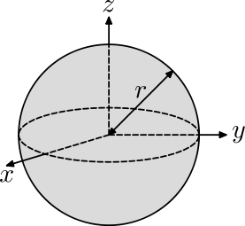
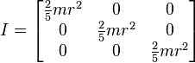
Mass Moment of Inertia
Inertia Tensor – Generalized version of a matrix
For purposes of games, most often 3x3
Diagonal Matrix for moments of inertia about x, y, z-axis
Off-center entries encode product of inertia
See http://en.wikipedia.org/wiki/List_of_moments_of_inertia

Slide 64
Inverse Inertia Tensor
Remember the calculation of forces
F = m * a → a = F / m
We need the inverse of the inertia tensor for the equivalent formula
Additionally, need to transform to the world coordinate system
Torques given in world coordinates

Slide 65
Integration
Add an accumulator for Torque
(D‘Alambert‘s Principle also works here)
Add all forces to linear accumulator
Calculate torque for each force
Add torques to torque accumulator
Integration
Multiply inverse mass moment of inertia with sum of torques

Slide 66
Handling non-spherical rigid bodies
E.g. a box
Can collide with any feature
Face
Vertex
Edge
If we handle only one feature, the others would sink
Sequential impulses
One part starts sinking into the floor
Push up → Rotation
Continue
Needs iterations to get stable

Slide 67
Handling non-spherical rigid bodies
E.g. a box
Can collide with any feature
Face
Vertex
Edge
If we handle only one feature, the others would sink
Sequential impulses
One part starts sinking into the floor
Push up → Rotation
Continue
Needs iterations to get stable

Slide 68
Friction
In the previous exercise, our spheres slided over the floor
No rotation
They came to rest because of dampening and not friction
Friction resists the spheres at the point of contact with the floor
Rolling along the floor
Different coefficients
Ice
Smooth floor
Sand
…

Slide 69
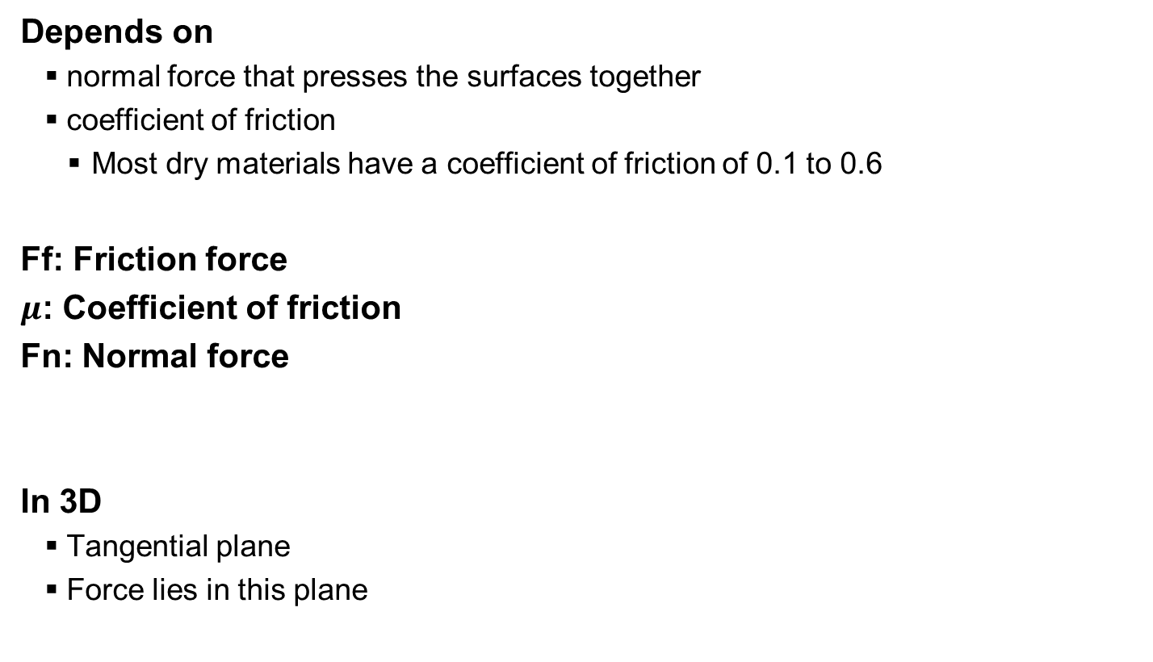
Coulomb‘s Law
Depends on
normal force that presses the surfaces together
coefficient of friction
Most dry materials have a coefficient of friction of 0.1 to 0.6
Ff: Friction force
$μ$: Coefficient of friction
Fn: Normal force
In 3D
Tangential plane
Force lies in this plane
Ff
Fn

Slide 70
Friction
Static friction
Keeps objects in place
Start moving when the limit is overcome
f_static <= k_static * |r|
k_static: Constant for friction between the involved materials
r: Reaction force of the ground at the point of contact
Dynamic friction
Force between the objects while they are sliding across
f_dynamic = -v_planar * k_dynamic * |r|
v_planar: The velocity of the object across the surface
k_dynamic: Constant for dynamic friction

Slide 71
Contact basis
Calculating friction requires us to calculate the velocity along the contact
Handle collision with a collision basis
3 orthonormal vectors
x: collision normal
y, z: Perpendicular to x, define the plane of the contact

Slide 72
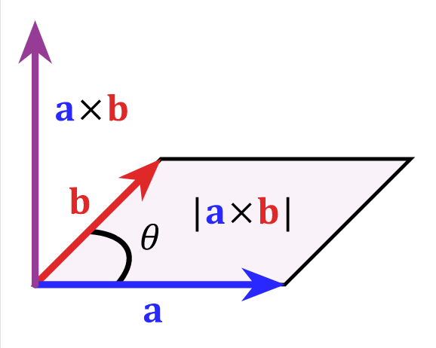
Calculating the contact basis
x: Contact normal
y: Choose a vector perpendicular to x
Cross product: A x B is perpendicular to A and B (unless they are parallel)
Use an axis, e.g. global z
y = x x (0, 0, 1)
Choose third vector to be perpendicular to x and y
z = x x y

Slide 73
Velocity resolution
Find contact basis
Calculate the change in velocity of the contact paint per unit impulse
Invert this to get a way to counter velocities
Calculate the x-term of the impulse (along the collision normal – our old calculation)
Calculate the y and z-terms of the impulse (for friction)
Apply the impulse

Slide 74
Velocity resolution
Find the collision collision normal and point of collision

Slide 75
Velocity resolution
Find the collision collision normal and point of collision

Slide 76
Velocity resolution
Find the collision basis

Slide 77
Identify the velocity of the collision point

Slide 78
Map velocity into the collision basis

Slide 79
X-Axis (= collision Normal)
Separate the objects (what we did last lecture)

Slide 80
Y and Z-Axis
Handle Friction

Slide 81
Apply changes as impulses
Changes to velocity and rotation

Slide 82
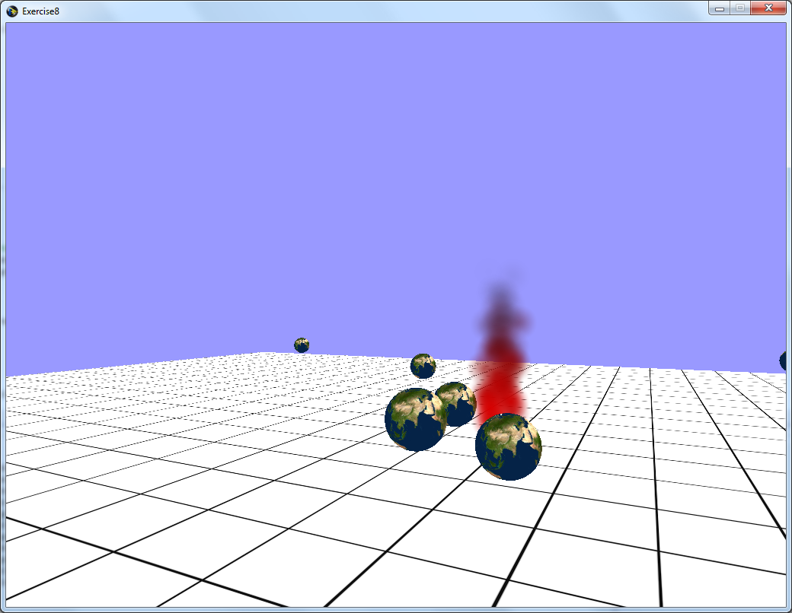
Exercise 8
Practical Exercise
Solution will be uploaded

Slide 83
Exercise 8 2.1

Slide 84
Exercise 8 2.2

Slide 85
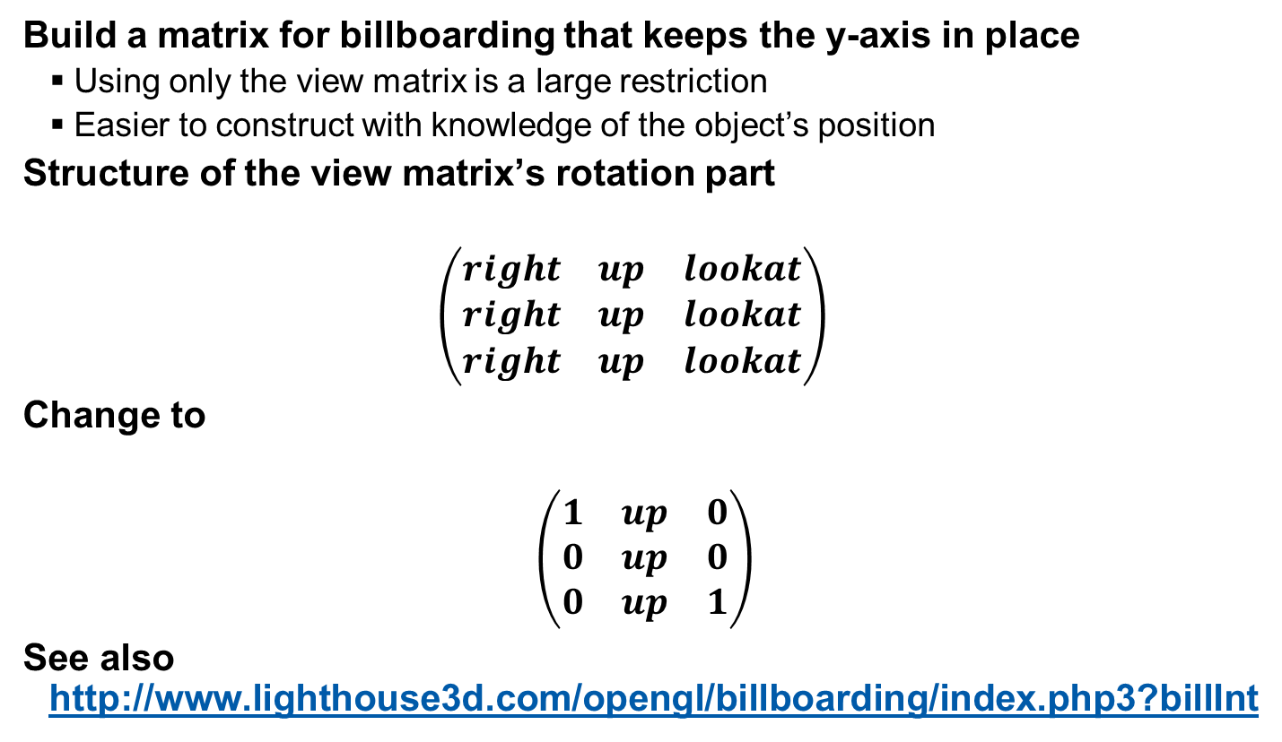
Exercise 8 2.3
Build a matrix for billboarding that keeps the y-axis in place
Using only the view matrix is a large restriction
Easier to construct with knowledge of the object’s position
Structure of the view matrix’s rotation part
$$\left(\begin{matrix}right & up & lookat \\ right & up & lookat \\ right & up & lookat\end{matrix}\right)$$
Change to
$$\left(\begin{matrix}1 & up & 0 \\ 0 & up & 0 \\ 0 & up & 1\end{matrix}\right)$$
See also http://www.lighthouse3d.com/opengl/billboarding/index.php3?billInt

Slide 86
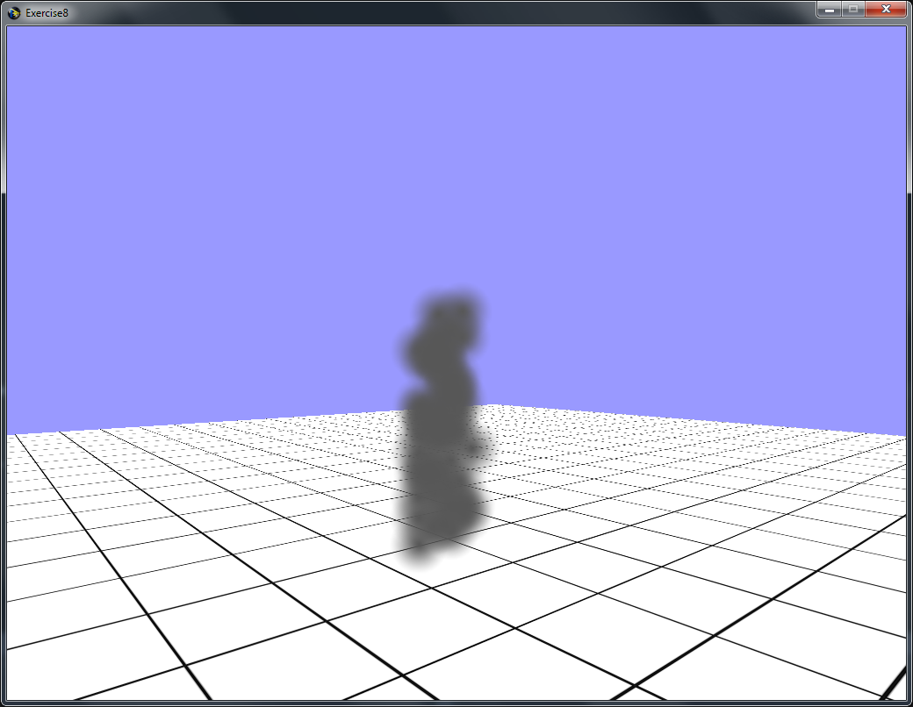
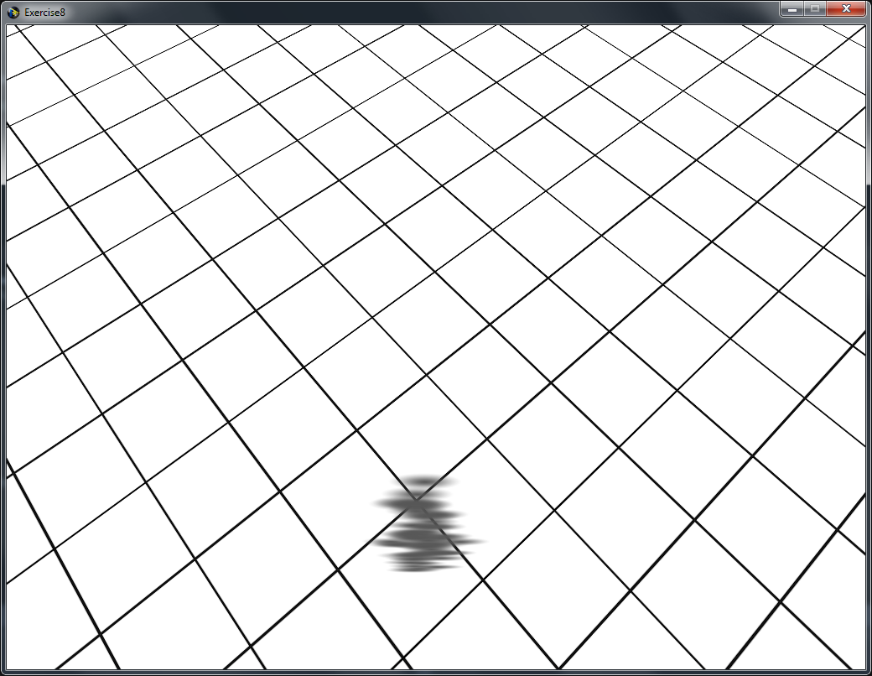
Exercise 8 2.3

Slide 87
Exercise 9 – Practical Tasks
1.1 Triangle-Sphere-Intersection – Check one of the SAT axes
1.2 Construct the collision basis
1.3 Implement a goal area – See task 2.1

Slide 88
Exercise 9 – Theoretical Task
Build the foundation for task 1.3
Describe a box-sphere intersection test
Either
Derive your own and describe it (does not have to be optimized)
Describe one from the literature (name your source)

Slide 89




Questions & Contact
RK
game-technology@kom.tu-darmstadt.de

